Slide 1

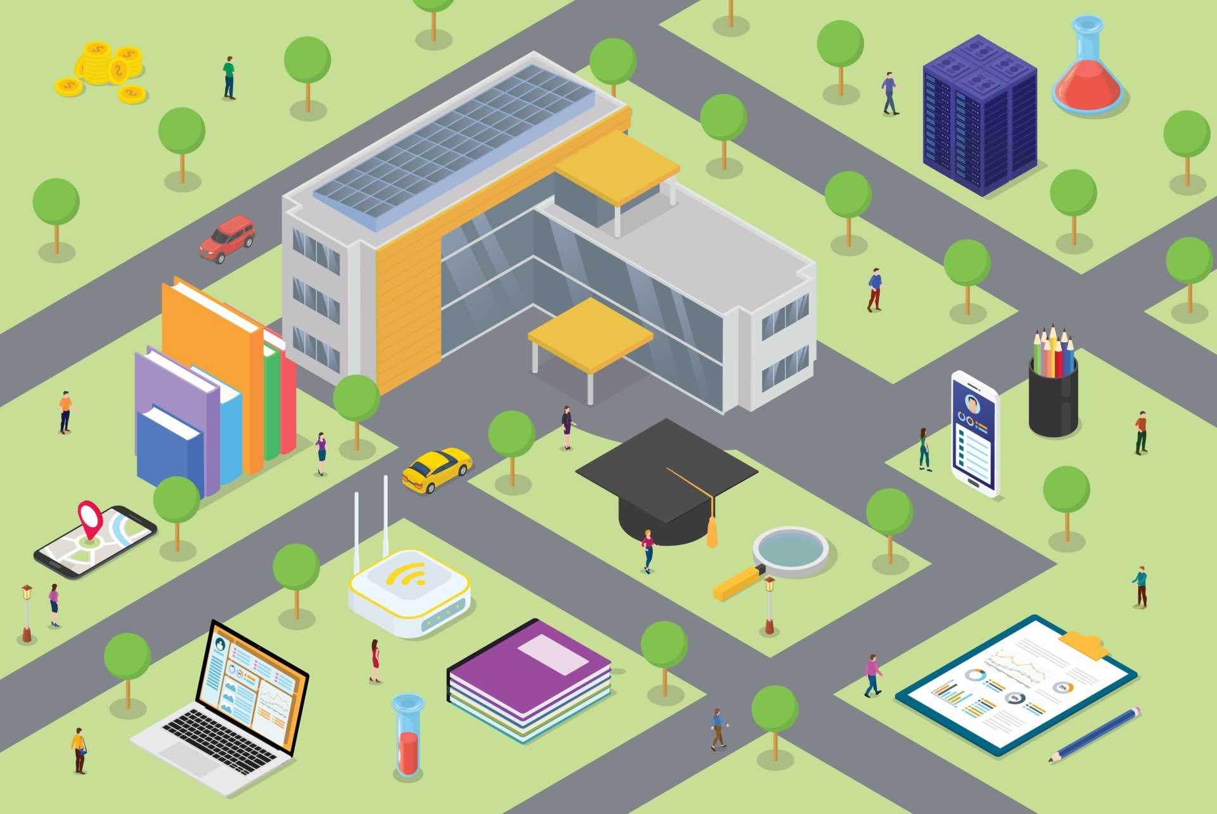
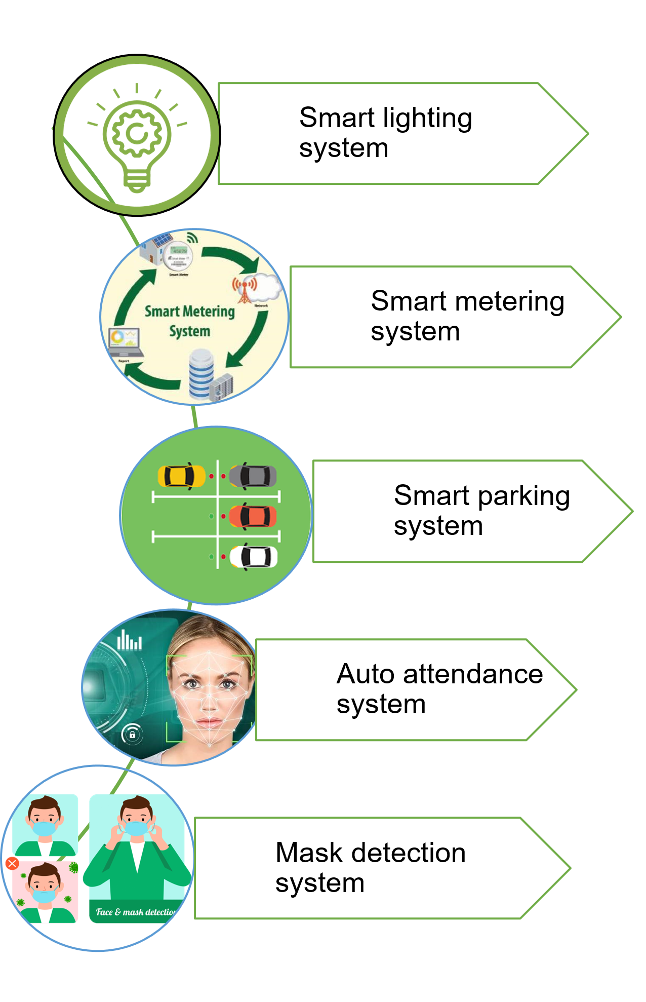

SMART CAMPUS
PROJECT
ABSTRACT
MOTIVATION
Many organizations including but not limited to colleges, schools, companies, and city halls are looking forward to smart cities. This project aims to focus on a smart campus as a basic model.This infrastructure will progressively allow one to monitor and efficiently manage the environment. Until recent years, IoT applications have been constrained by limited computational capacity and especially by efficient communications, but the emergence of new communication technologies allows us to overcome most of these issues. This situation paves the way for the fulfillment of the Smart-City concept, where the cities become a fully efficient, monitored, and managed environment able to sustain the increasing needs of its citizens and achieve environmental goals and challenges.
Our Motivation is to help increase the quality of life for all people. by using networked technology to improve cooperation, resource efficiency, security, and cost savings, and render the institution more integrated and pleasurable. Institutions may use a smart campus to integrate systems like smart lighting that control light intensity and save power, Smart parking to manage the cars and improve security by saving the driver's ID to help to trace him., Smart metering that controls power consumption, Smart attendance that record the present students using a camera, mask detection that permits only the student who wears a mask to enter the gate.
OBJECTIVE
PROBLEM
•Being able to record information about the consumption of electric energy, voltage levels, Current, and power factors.
•Being able to reduce power consumption and cost .and able to easily control the devices that consumed large power
•Being able to control the intensity of the lighting by LDR.
•Being able to control street lighting using a real-time clock by setting the sunrise and sunset time.
•Being able to allow the user quick access which helps in the reduction of time in searching the parking spot, reducing traffic congestion.
•Being able to add security as every user has its id and save the time of entrance and existence in a cloud server.
•Being able to use the Face recognition algorithm for recording the attendance of students in a classroom.
•The ability for the teacher or doctor to have an excel sheet with the student attending the lecture.
•Being Able to detect people wearing a mask to reduce harmful effects on health and reduce the spreading of diseases.
In Traditional Learning Environment, Higher Education Institutions compete on various levels to attract students. our lives are already embedded with smart technologies in our cars, stores, banks, and our homes. We interact with smart environments regularly. And, yet, many universities are still inundated with siloed infrastructures that often do not serve or communicate outside of their associated stakeholders.
Modern students are digital natives, they want to have a well-rounded and seamless experience with technology that integrates into their everyday life and just does everything more smartly. so it must be changed so that the old traditional campus becomes a modern smart campus that talks to students. A smart campus is an interface between smart homes and smart cities. Through intelligently connected everyday university life, like many other smart apps and experiences, it's about communicating with other systems, devices, or the Internet.
to improve efficiencies and enhance the experience of students and staff on campus. It offers entirely new opportunities to the organization itself with a potential increase in operational efficiency, cost savings, and the improvement of public safety.
SOLUTION
IMPLIMINTATION
CONCLUSION
For the previously explained reasons in problem swction, we solved it by a group of sub-systems in our project for example a smart parking system solves the parking issue. A smart parking system allows the user quick access which helps in the reduction of time in searching the parking spot, reducing traffic congestion. It can be used to monitor parking systems and exhibit the parking lot situation at any given moment.
Smart Lighting system to increase the accuracy and efficiency of street lighting, and therefore solve the problem of accidents occurring in the nighttime is either caused by driver errors or malfunctioning streetlights The malfunctions can be caused by fused bulbs or damaged wiring. This project reduces this error hence reducing accidents significantly.
A smart metering system that records information about the consumption of electric energy. then communicate the information to the consumer for greater clarity of consumption behavior, and electricity suppliers for system monitoring and customer billing.
Auto Attendance System which uses the Face recognition algorithm for recording the attendance of students in a classroom. The idea of the project is very helpful so the teacher or doctor to have an excel sheet with the student attending the lecture.
Mask Detection system that detects people wearing a mask to reduce harmful effects on public human health.
Smart campus system consists of Sub-systems :
1-Smart lighting System
The Smart Street Lighting System is an advanced lighting system that is designed to increase the accuracy and efficiency of the streetlight by timed controlled Switching.
And also to reduce energy wastage and accidents that caused by malfunctioning streetlights.
2-Smart Metering System
The Smart Metering System is designed to record information about the consumption of electric energy, voltage levels, Current, and power factors.
And to communicate the information to the consumer for greater clarity of consumption behavior, and electricity suppliers for system monitoring and customer billing.
3-Smart Parking System
A smart parking system is private parking for the campus area that can be used by special drivers with authorized access to the parking. It solves the parking issue and allows the user quick access which helps in the reduction of time in searching the parking spot, reducing traffic congestion. It adds also some of security as it monitors parking systems , exhibits the parking lot situation at any given moment and Stores the time of Entrance and existence of the driver.
4-Mask detection System
Mask detection system detects whether a person is wearing a mask or not we can control to open the gate and let the person pass. .it’s designed to reduce the harmful effects on global economic and public health by reducing infection rate.
5-Auto Attendance using Face recognition
we use the Face recognition algorithm for recording the attendance of students in a classroom. The idea of the project is very helpful so the teacher or a doctor will have an excel sheet with the student attending the lecture. Face recognition is a very common computer vision application that needs previous knowledge of Open-CV for image processing, Keras Api, numPy, and matplotlib for visualization.
In this project we have been able to operate a central server that automatically performs tasks, decides to open the gate, control street lighting, provide available parking spaces on the map, and record class attendance. It can help reduce energy consumption, reduce electricity costs, enhance security and manage resources.

